Slide 1
Advanced Text Versioning system
Student Details

Slide 2
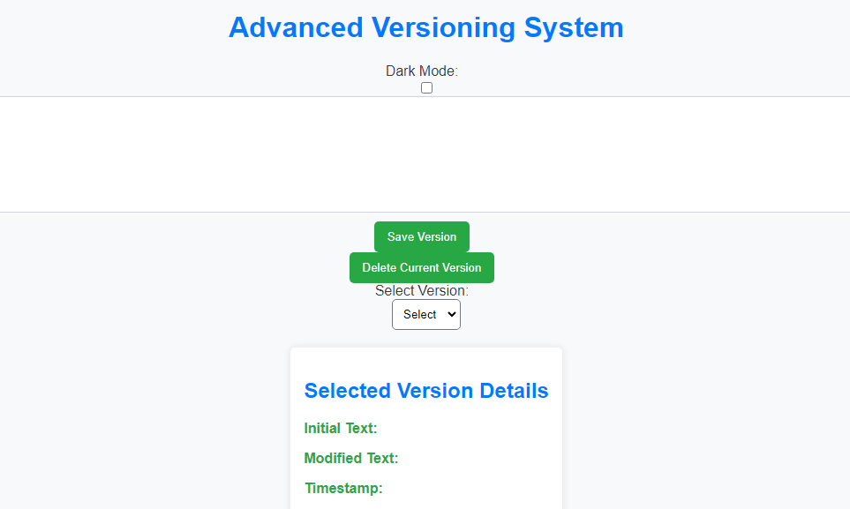
Introduction
The text Versioning System is an application for management and tracking of different versions of text content.
It provides a reliable solution for users

Slide 3
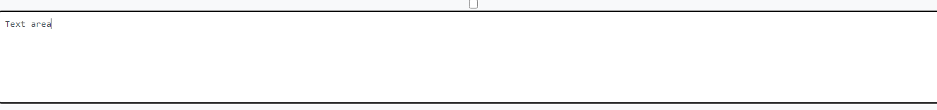
User interface
The user interface is clean and user-friendly.
The design prominently features a text area for input
Key functionalities such as saving versions, deleting versions, and version selection are easily accessible

Slide 4

Saving versions
Saving versions of the text versioning system is a straightforward process.
Users can click the "Save Version" button to store the current text as a new version.
It is not possible to save an empty content.

Slide 5

Version Selection
The version selection dropdown is a pivotal feature.
Users have the flexibility to choose a specific version from the dropdown menu
They can load and view their content as it existed in previous changes.

Slide 6
Deleting Versions
Deleting versions is also allowed in the System.
Users can remove a selected version, but not without a confirmation step.

Slide 7

Dark mode
The system caters to user preferences with a dark mode feature.
It enhances the overall user experience with an alternative visual style.

Slide 8
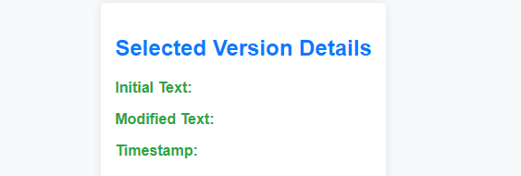
Selected version details
The "Selected Version Details" section provides users with a comprehensive overview of the chosen version.
It displays not only the initial and modified text but also the timestamp of the selected version.

Slide 9
Conclusion
The Advanced Versioning System offers a robust solution for users seeking efficient text version control.
User-friendly interface and intuitive functionalities provide seamless experience in managing textual changes.

